Slide 1



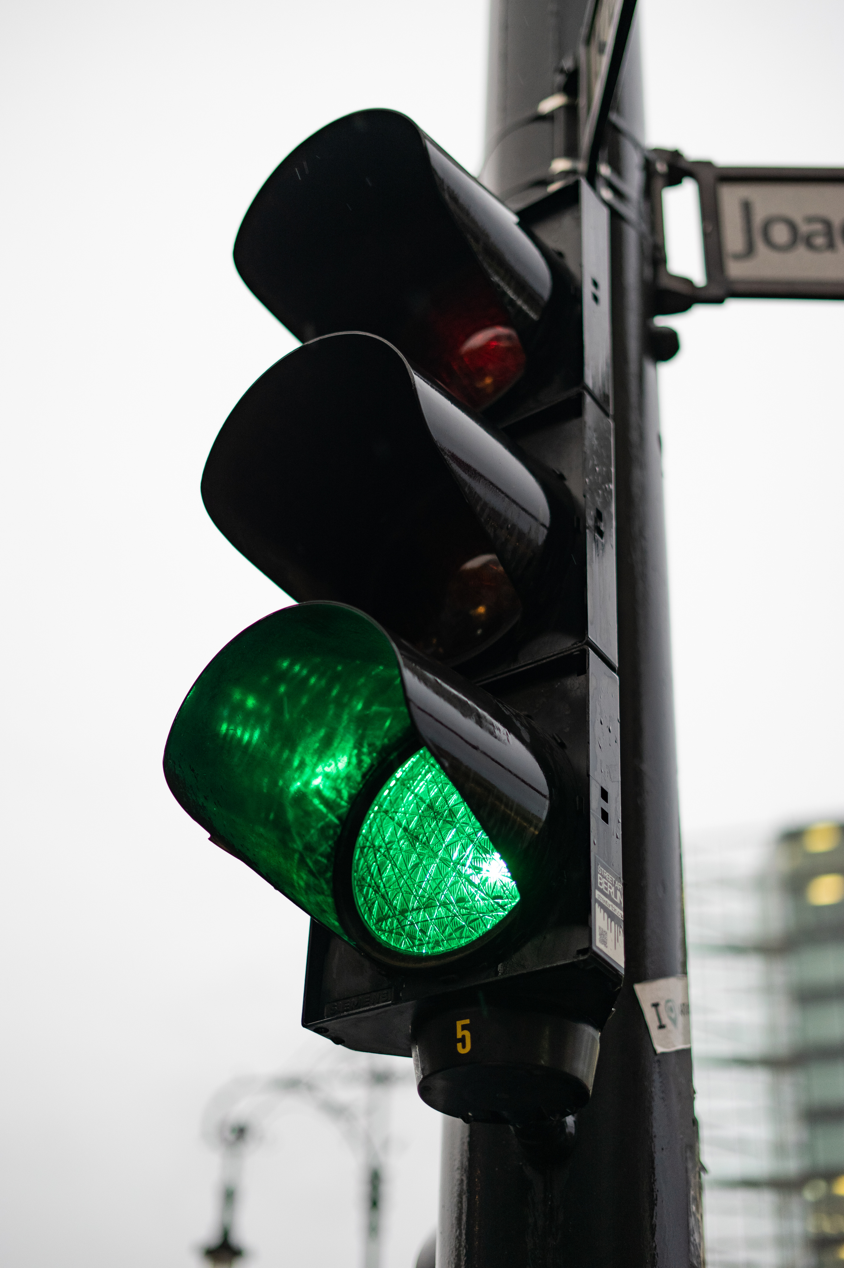

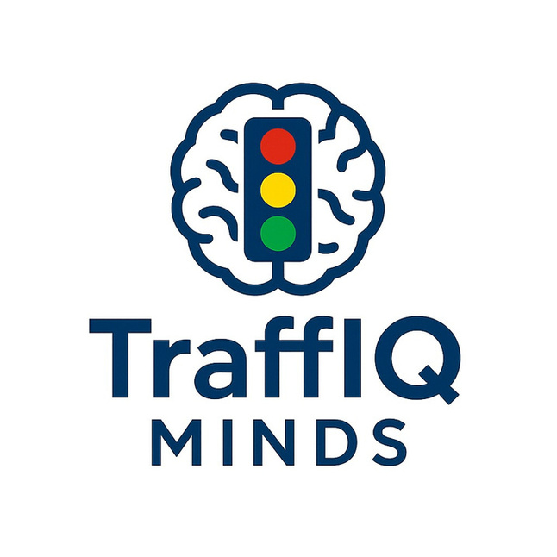




FOUNDER-KANCHAN SAIN
CO-FOUNDER - NIHARIKA SHARMA
TECHNICAL-PRACHI JHA
RESEARCHER -PRAGYA KATARIA

Slide 2
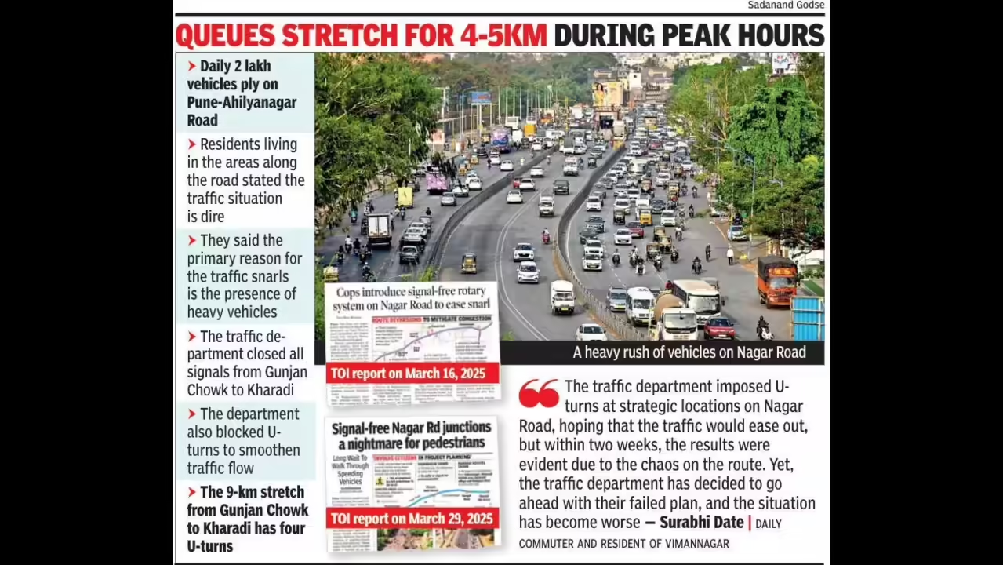
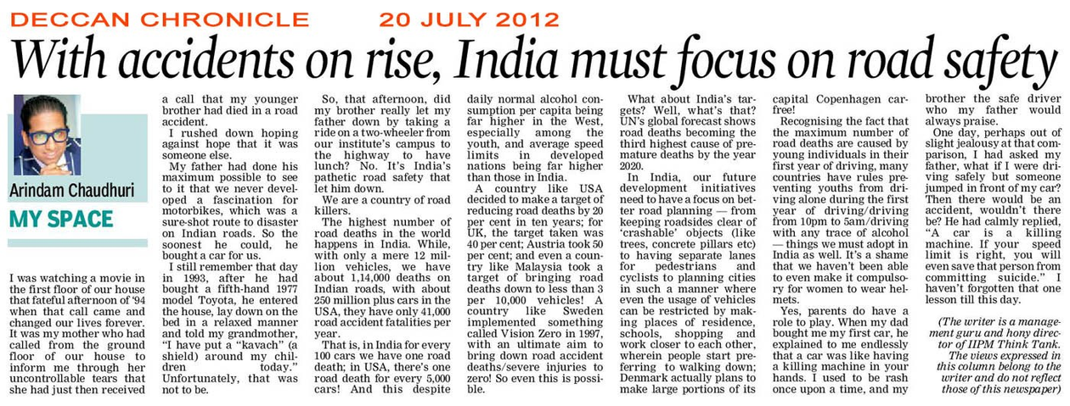
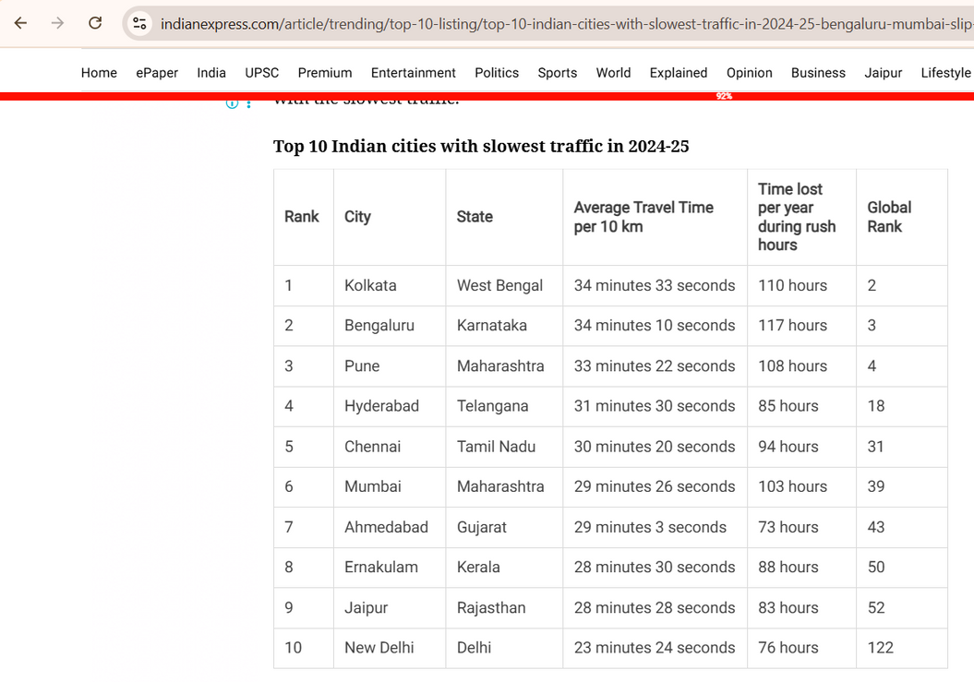
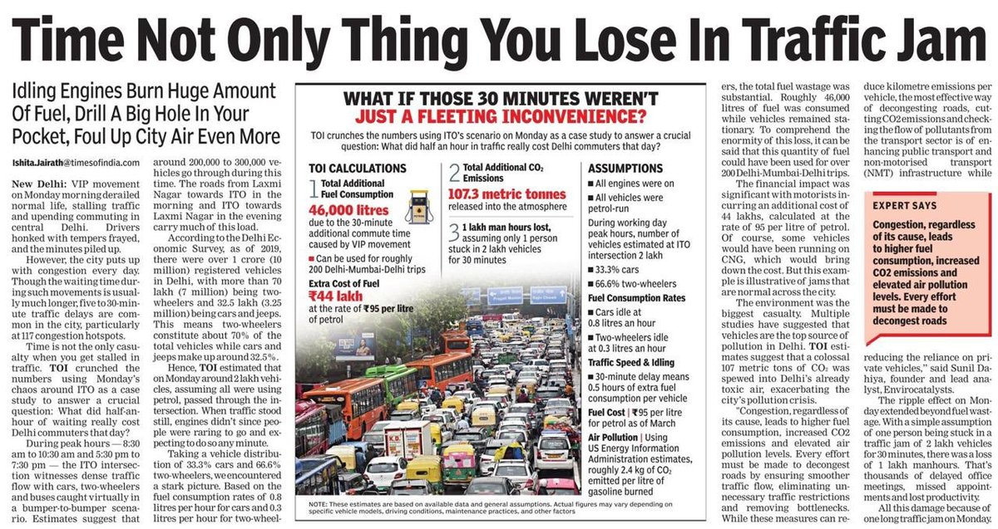
Apr 17, 2025

Slide 3


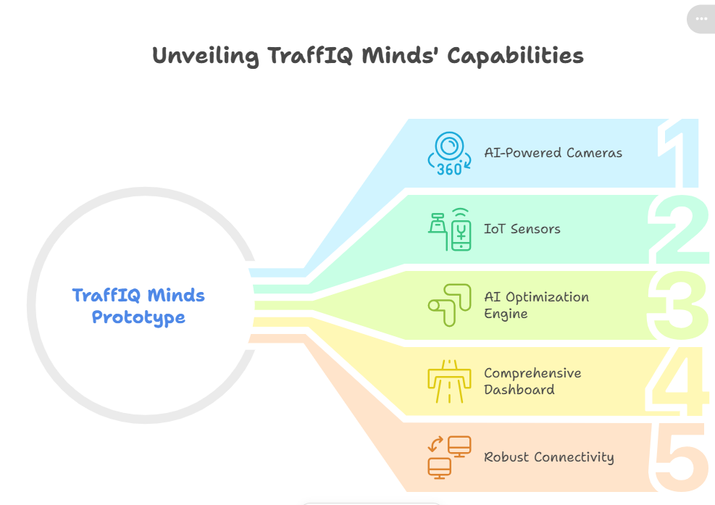




Problem Statement
Traffic congestion at intersections.
Long waiting times at signals.
Fuel wastage & economic loss.
Increased accidents & poor road discipline.
Uniqueness
360° AI Vision
Dynamic Signal Adjustment
Centralized Dashboard
2

Slide 4
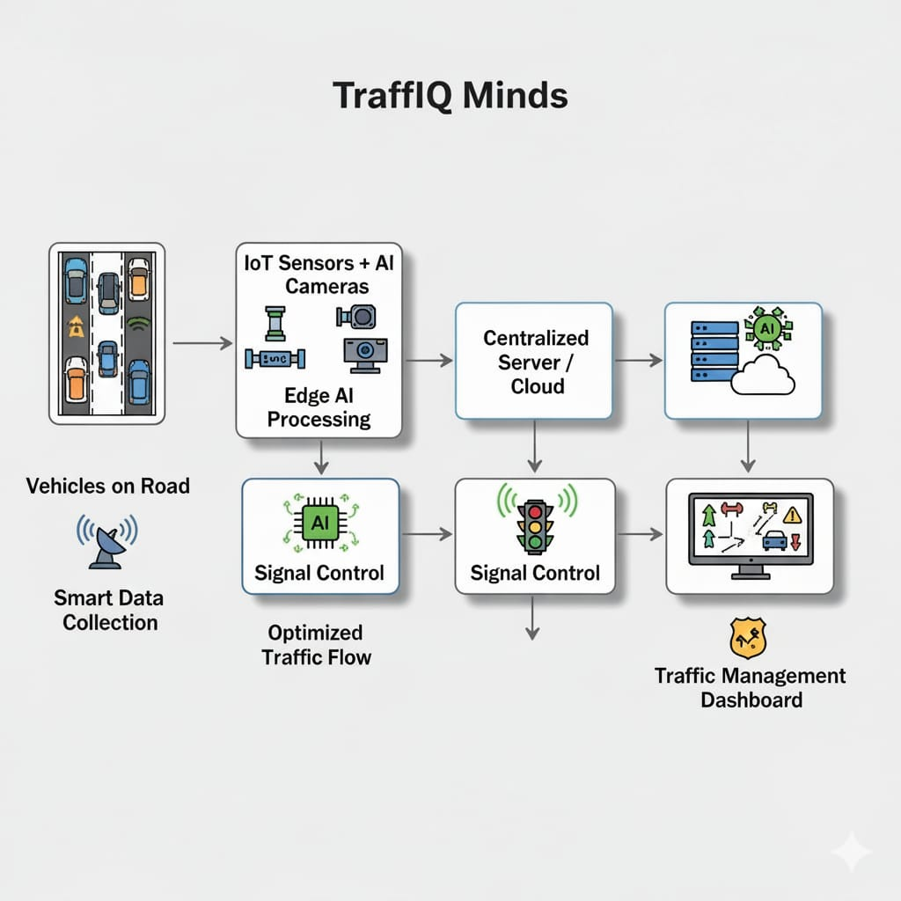


TECHNICAL APPROACH
Data Collection → IoT sensors + AI cameras capture traffic
Data Processing → Edge AI (real-time)
Communication → 5G/IoT protocols connect signals with control room
Decision → AI optimizes signal timing & predicts congestion
Control & Action → Central room + Police dashboard for monitoring & alerts
Feedback → System learns from patterns, improves over time
Ref.
https://preview--smart-commute-pulse.lovable.app/dashboard

Slide 5
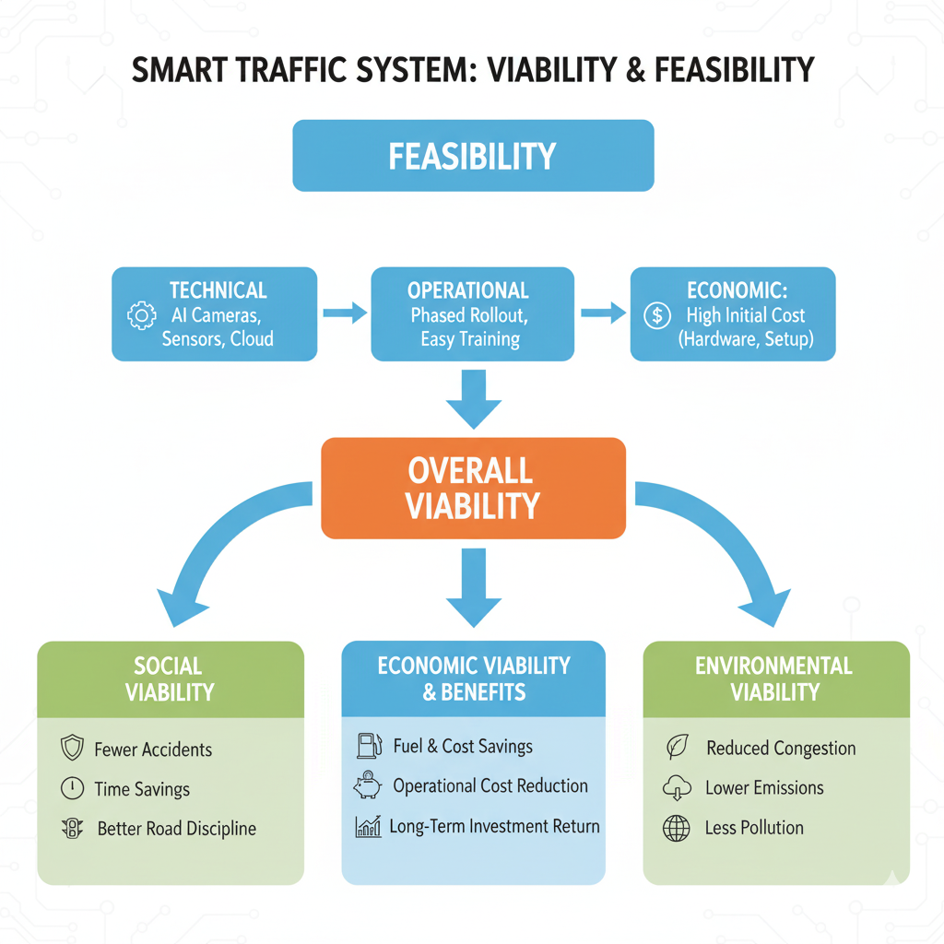
FEASIBILITY AND VIABILITY
Feasibility of Idea
Viability
Technical: AI cameras, IoT sensors, dashboards already exist; cloud/satellite ensures reliability.
Operational: Start with few intersections, easy training for traffic staff.
Economic: High initial cost, but long-term savings in fuel, manpower & congestion reduction.
Social: Fewer accidents, time savings.
Economic: fuel & cost savings.
Environmental: Reduced congestion = less pollution.
4

Slide 6

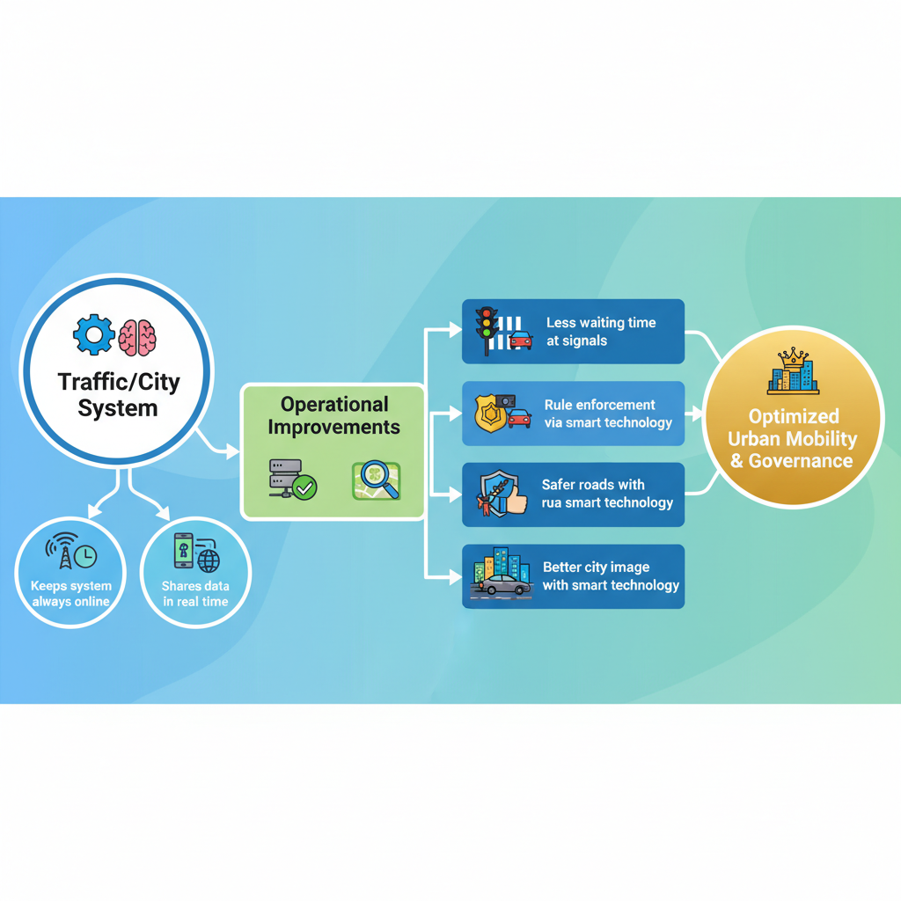

IMPACT AND BENEFITS
Impacts
Faster and smoother travel.
Less waiting time at signals.
Safer roads with rule enforcement.
Better city image with smart technology.
Benefit
Keeps system always online
Shares data in real time
https://ai.invideo.io/watch/xB5nNNPaurJ
5

Slide 7

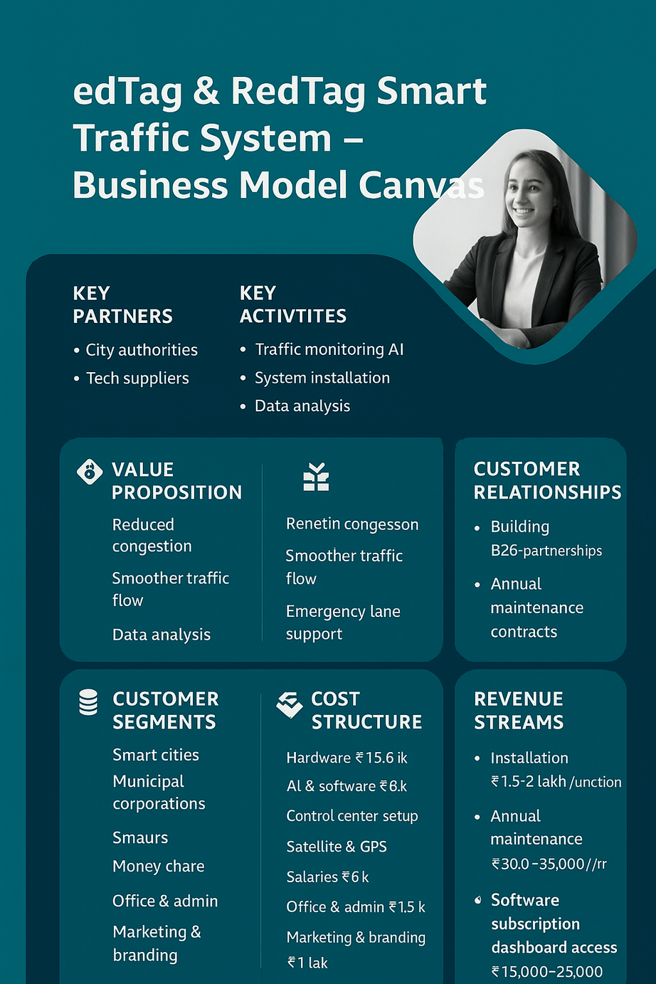

Business Model Canvas

Slide 8
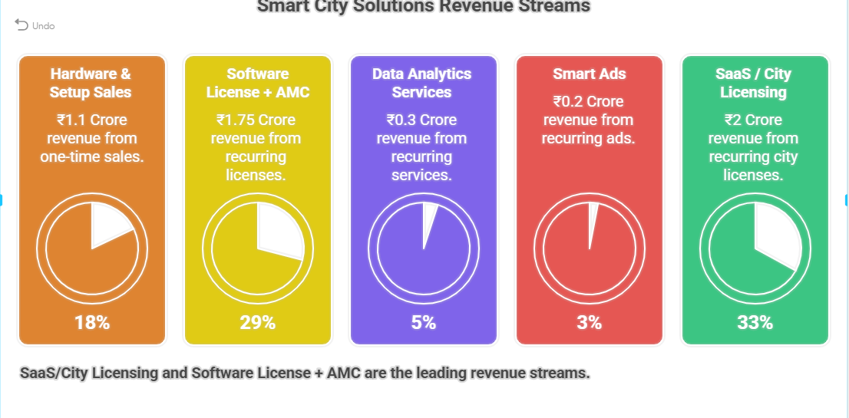
REVENUE STREAM
The total budget allocated by the Jaipur government specifically for addressing traffic congestion in 2025-26 is approximately ₹250 crore
REF.
https://toppersnotes.co/current-affairs/blog/rajasthan-budget-2025-26-transport-infrastructure-investments-19-feb-2025

Slide 9
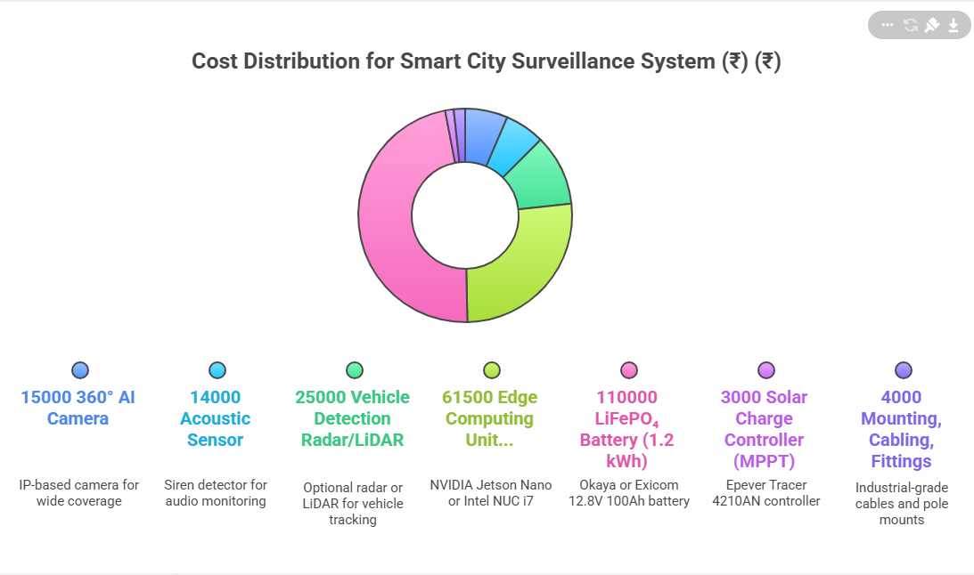
COST STRUCTURE

Slide 10



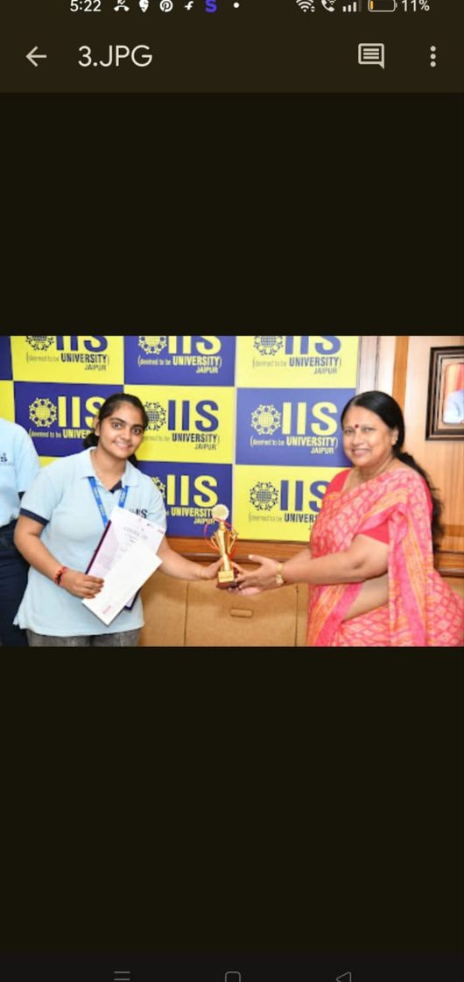

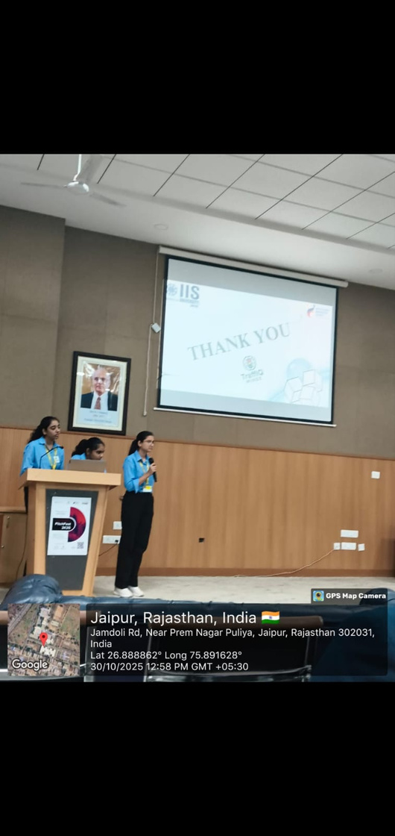
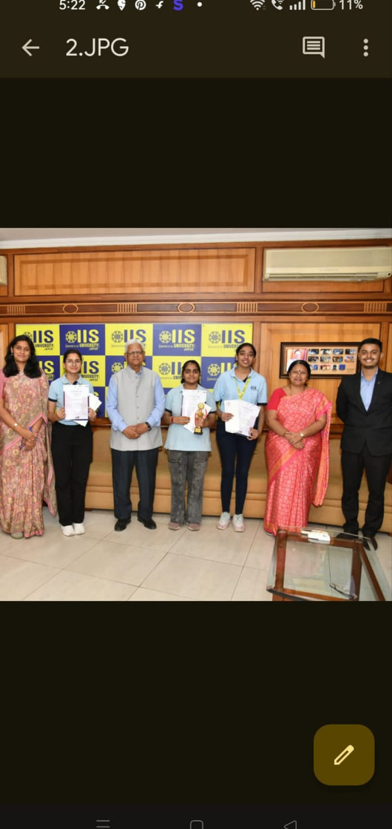

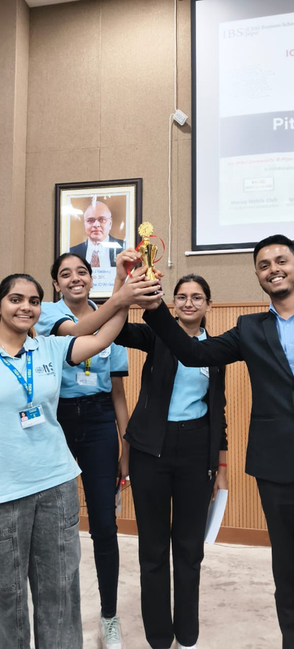

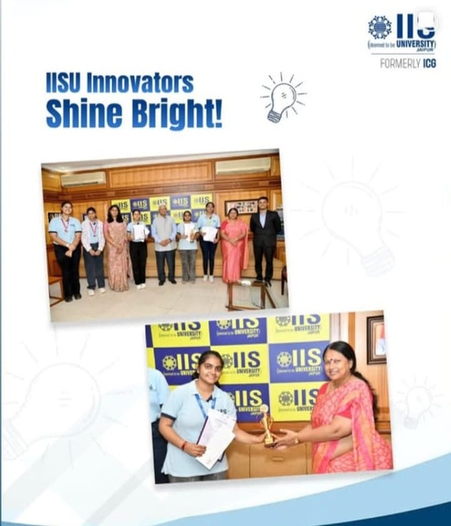
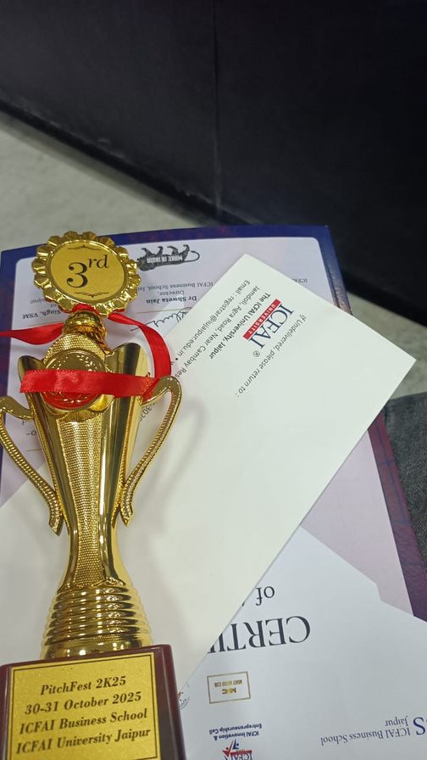



“Achievements”

